Slide 1
Internet Of Things
Flood Monitoring &Early Warning
SALMAN FARAS
SIBIRAJAN
DEEPAN KUMAR
PREM KUMAR
VASU

Slide 2
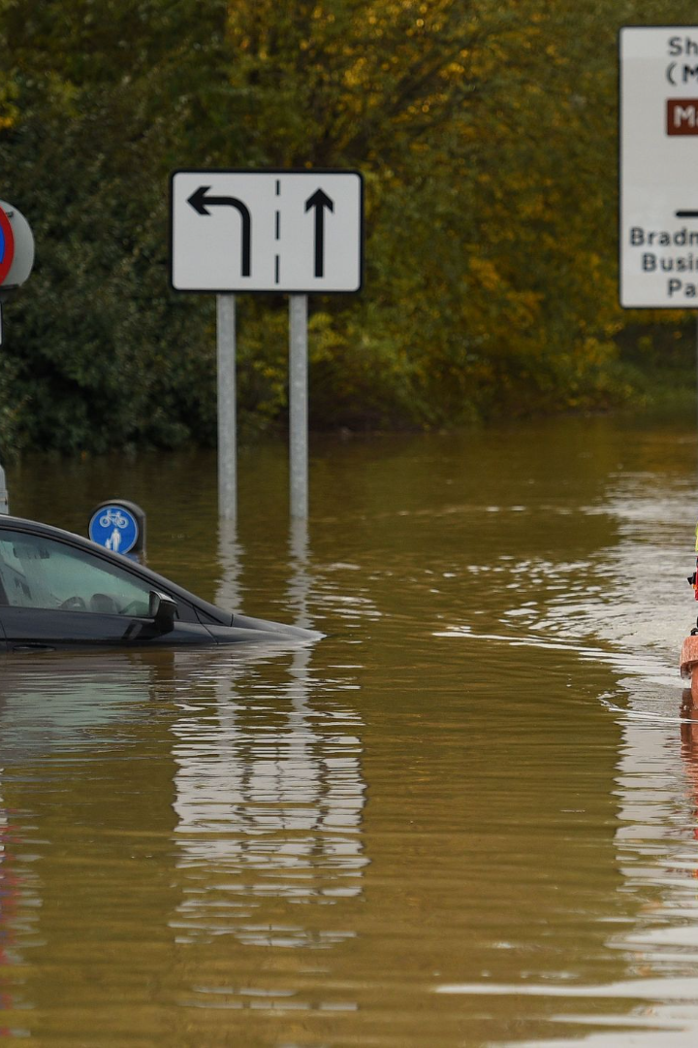
Improving Early Flood Warnings with Predictive Modeling and Historical Data
Discover how predictive modeling and historical flood data can elevate early warning systems, improving accuracy and enhancing flood preparedness.

Slide 3

The Importance of Early Flood Warnings
1
Lives Saved 💙
2
Property Protection 🏘️
3
Disaster Response 🚑
Timely warnings help evacuate residents and minimize casualties in flood-prone areas.
Early alerts enable better preparation, reducing damage to infrastructure and homes.
Efficient alerts facilitate effective mobilization of emergency responders and resources.

Slide 4

Predictive Modeling: Unlocking Accuracy
1
Advanced Analytics 📊
2
Rapid Detection ⚡️
Identify potential flood risks in real-time, allowing for timely warnings and preparation.
Predictive modeling combines data analytics and algorithms to forecast flood events.
3
Enhanced Decision-making 💡
Enable authorities to make informed decisions based on accurate flood predictions.

Slide 5

Historical Flood Data: Insightful Patterns
1
Uncovering Trends 🌊
2
Event Mapping 🗺️
Examine historical flood data to identify patterns and understand the behavior of flood events.
Geospatial analysis using historical data helps pinpoint high-risk flood zones.
3
Model Calibration ⏳
Incorporate historical data into predictive models for more accurate and reliable flood forecasts.

Slide 6

Challenges: Improving Accuracy and Reliability
1
Data Accuracy 📏
2
Model Selection ⚙️
Evaluate the quality and completeness of available data to ensure accurate modeling.
Choose appropriate modeling techniques that align with the characteristics of flood-prone areas.
3
Reducing Uncertainty ❓
Balancing false positives (over-warning) and false negatives (under-warning) to optimize early warning systems.

Slide 7
Implementing Predictive Modeling in Early Warning Systems
1
Data Collection 📚
Collect and analyze real-time data from various sources to support accurate modeling.
Model Development 🧪
2
Build robust predictive models using machine learning algorithms and historical data.
3
System Integration 🖥️
Integrate predictive models into existing early warning systems to enhance their capabilities.

Slide 8
Collaborative Efforts for a Resilient Future
Public Authorities 🏛️
Academic Research 🎓
Continuous Updates 🔄
Partner with government agencies to access their data and collaborate on model development.
Engage researchers to advance predictive modeling techniques and flood risk assessment.
Maintain and improve models with constant monitoring, incorporating new data and insights.

Slide 9
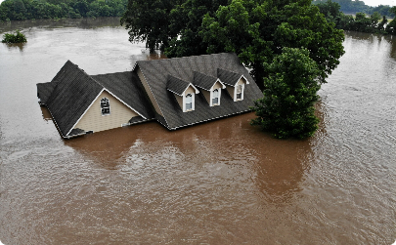
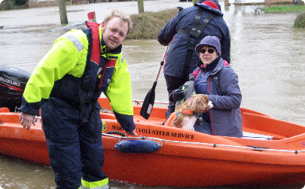

Conclusion: Enhancing Flood Preparedness
Reduced Losses 💔
Swift Response 🚁
Constant Innovation 💡
Improved early warnings lead to reduced losses of life and property due to floods.
Timely alerts enable quick deployment of rescue and relief operations.
Continued research and development ensure advancements in flood prediction and preparedness.

